Slide 1
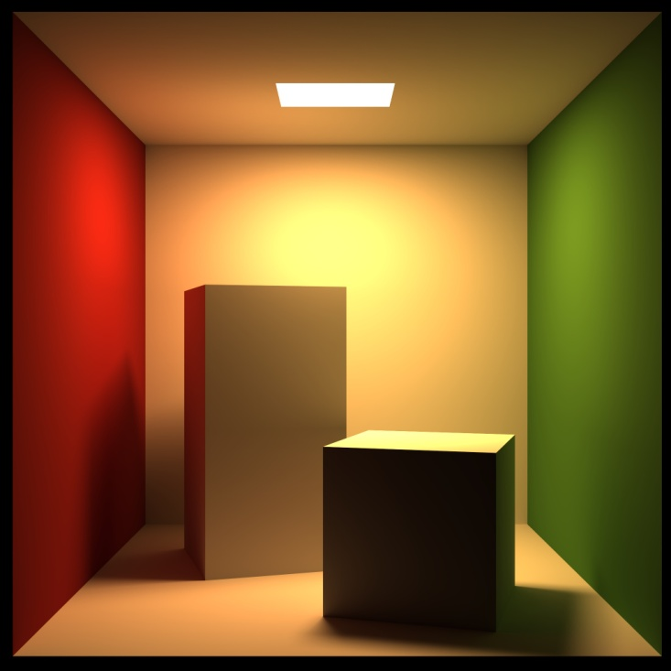
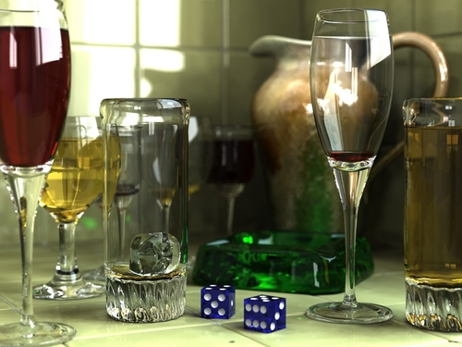
RAY TRACING ON GPU
By:
Nitish Jain

Slide 2
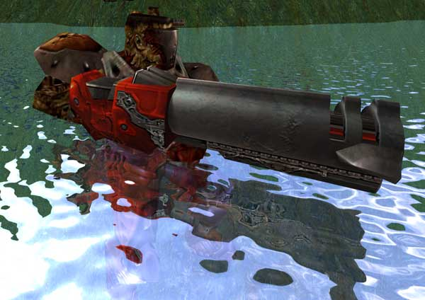
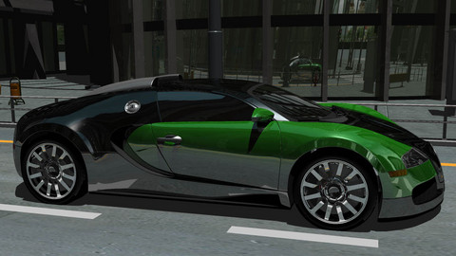
Introduction
Ray Tracing is one of the most researched fields in Computer Graphics
A great technique to produce optical effects such as shadows, reflectivity and translucency
Widely used in the industry to create convincing images
Some examples of ray traced images

Slide 3
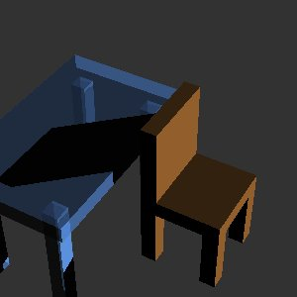
And this one..

Slide 4
Road Map
Ray Tracing: Some Background
Rasterization: An Alternative
Rasterization vs Ray Tracing
Problems with Ray tracing
Related Work in the Field
Important research papers
  Real Time Ray Tracing with CUDA
  Real Time Ray Tracing on GPU with BVH based Packet Traversal
A critique
Summary
References

Slide 5
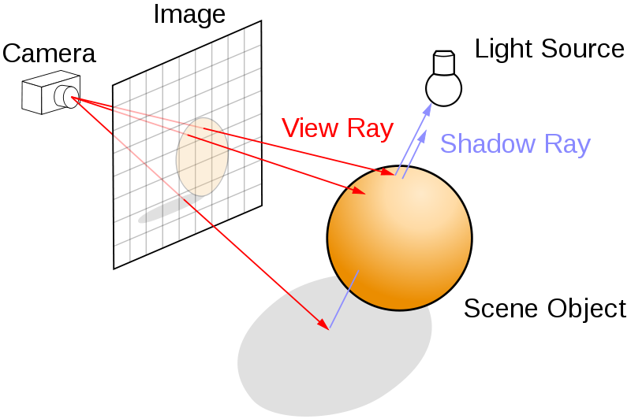
What is Ray Tracing?
Rays through each pixel in an image plane are traced back to the light source(s)
Core Idea: Efficient ray-primitive intersection algorithms
Naïve way: O(n²) comparisons
Optimized way: Use of some sort of spatial data structures to make it faster by means of culling
Super optimized way: Use Parallelism or employ GPUs to do this work!
(Adapted from Wikipedia)

Slide 6

A popular Alternative: Rasterization
Simple rendering algorithm to display 3D objects on a computer screen.
Popular technique for real time 3D graphics in interactive applications like games
Simply the process of mapping from scene space to pixel space without any effort to compute the color of the pixels
A pixel space depiction of a raster image

Slide 7
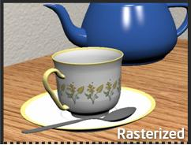
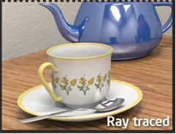
Rasterization vs Ray Tracing
Rasterization
  Fast and suited for real time applications
  Does not support complex visual effects, but some cleverness can produce those to some extent
Ray Tracing
  Time consuming and needs a lot of optimization to be used in real-time such as Kd trees
  Can produce stunning images with complex visual effects

Slide 8
Problems with Ray Tracing
PERFORMANCE!
  Much of the research is focused on how to make it more efficient in terms of time
  Quality comes at a cost!
Results produced by ray tracing, although stunning, are still far away from reality
  Need to implement the rendering equation more accurately
  Radiosity Rendering Technique and Photon mapping address this issue

Slide 9
Related Work in the field
Ray Tracing on GPUs has been around in the academic circles for some years now with a focus on improving performance.
Some of the notable papers on the topic:
  Ray Tracing on Programmable Graphics Hardware
  Timothy J. Purcell Ian Buck William R. Mark Pat Hanrahan
  Stackless KD-Tree Traversal for High Performance GPU Ray Tracing
  Stefan Popov, Johannes Günther, Hans-Peter Seidel, Philipp Slusallek
  Fast Ray Sorting and Breadth-First Packet Traversal for GPU Ray Tracing
  Kirill Garanzha, Charles Loop
Following few slides provide a brief overview for each of the above papers

Slide 10
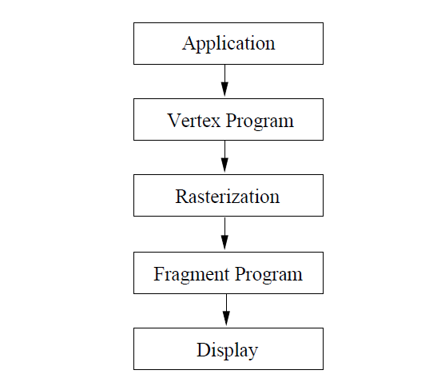
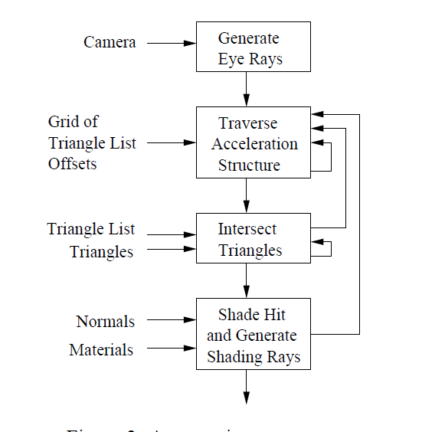
Ray Tracing on Programmable Graphics Hardware
GPU Pipeline
Streaming Ray Tracing

Slide 11
Target GPU requirements
A programmable fragment stage with floating point instructions and registers
Floating point texture and framebuffer formats
Enhanced fragment program assembly instructions
No limits on the number of texture fetches or levels of texture dependencies within a program
Multiple outputs - allow 1 or 2 floating point RGBA (4- vectors) to be written to the framebuffer by a fragment program.
Fragment program can render directly to a texture or the stencil buffer
  Texture lookups are allowed anywhere within a fragment program
  For looping:
  Multipass Architecture
  Branching Architecture

Slide 12
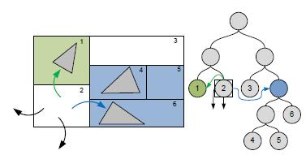
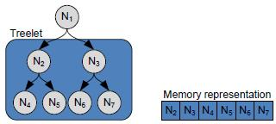
Stackless Kd-Tree Traversal
Kd Trees are the most efficient data structure for static scenes
Eliminate the need of maintaining a stack while traversal by making use of rope links for neighboring cells
Optimized tree storage:
  Geometry data in leaf with its AABB and its ropes to increase the chance of having the data in shared memory
  Non leaf nodes stored as tree-lets, allows for memory coherence

Slide 13
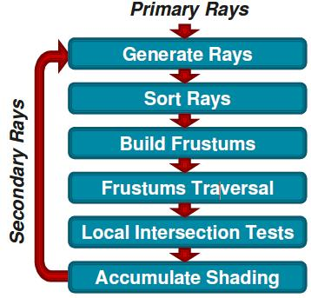
Fast Ray Sorting and Breadth-First Packet Traversal
4 stages of trace() method:
  Ray Sorting into coherent packets
  Creation of frustums of packets
  Breadth-first frustum traversal through a BVH
  Localized ray-primitive intersection tests
Frustum creation for a packet of sorted coherent rays done in a single CUDA kernel, each frustum computed by a warp of threads.
CUDA kernel for localized intersection tests:
while(ray warps are available) { // persistent
RayWarp = fetch_next_warp(); // threads [AL09]
Ray = fetch_ray(RayWarpBase + threadIdx.x);
FrustumId = frustum_id(RayWarp);
for(all leaves(FrustumId))
if(Ray intersects AABB(Leafi))// mask rays
for(all primitives(Leafi) // coherent reads
intersect Ray with a primitivej;
}

Slide 14
REAL TIME RAY TRACING USING CUDA
Min Shih1, Yung-Feng Chiu¹, Ying-Chieh Chen¹, Chun-Fa Chang²
¹ National Tsing Hua University, Taiwan
² National Taiwan Normal University, Taiwan

Slide 15
Motivation and Contributions
A widely used algorithm for high quality image production
Due to its intrinsic parallelism, forms a good fit for muti-core or multi-processor architectures
One of the fastest implementations on GPU for relatively complex scenes
Shedding light on various performance issues in practice when implementing on GPUs

Slide 16
Why CUDA?
CUDA alleviates the problems with traditional development platforms on GPU
CUDA eliminates the hassles of mapping the application to graphics API
Access to DRAM using general addressing
Full support for integer and bitwise operations
Access to on-chip shared memory allows for higher speed optimizations

Slide 17
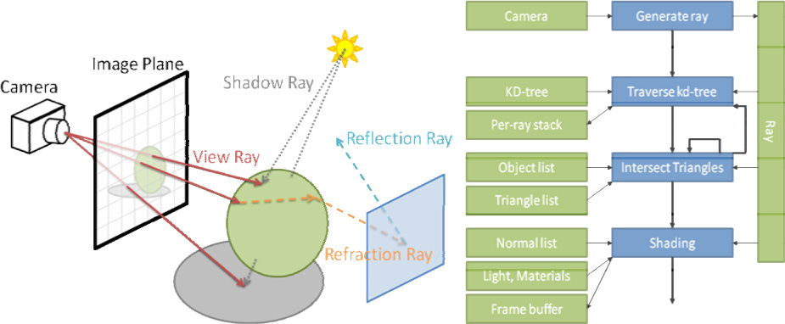
Ray Tracing Kernel

Slide 18
Data Organization on GPU
Allocate data structures to avoid long access latency caused by low-speed memory
Object list as a middle layer between leaf nodes and triangles reduces memory consumption in the case of shared triangles among different leaf nodes
Node list, object list, triangle vertex list and normal list as textures
Camera, light and materials in constant memory
Ray stored in shared memory as two 3D vectors
  Optimization over storing it in local memory due to its access pattern

Slide 19
Kd Tree Traversal
Most time consuming part, thus, potential for optimization
Kd Tree Traversal Issues
  Single Ray vs Packet
  For CUDA single ray executed in parallel, so that is efficient too
  Stack vs Stackless
    Stackless was good since implementing per ray stack was prohibitive on GPUs
    CUDA solves this by general DRAM addressing
    Use of stack keeps the kernel simple, the CUDA way!

Slide 20
Triangle Intersection
Möller-Trumbore Test
Most common since requires just the vertices of the triangle
Test Projection Test
Takes advantage of a pre computed acceleration structure
Plücker Test
Workes with Plucker coordinates instead of Barycentric coordinates

Slide 21
Shadow Rays and Secondary Rays
Shadow Rays
  One Pass
    Shadow processing part of the primary kernel
    Complicates the kernel, saves overhead
    Increase in register usage
  Two Pass
    A separate kernel for shadow calculation
    Overhead of kernel invocation
    Global buffer for communication
Secondary Rays
  Separate Kernels due to potentially large number of rays per primary ray
  Simulate recursion by means of kernel tree instead of traditional ray tree
  Weight for each ray, final step will be accumulation
  Invoke kernels in appropriate order, depth first
  Use of global buffer for communication

Slide 22
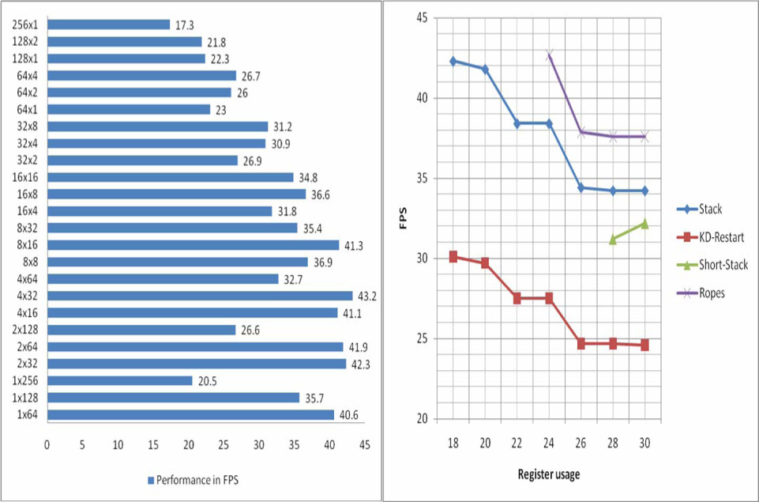
Results
2x32 and 4x32 block sizes perform
Best due to high coherence within
32 thread warp
3 keys: high occupancy, high coherence
Within a warp and high coherence within
A multiprocessor

Slide 23
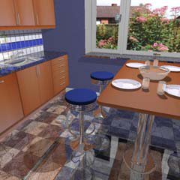
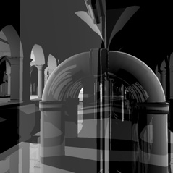
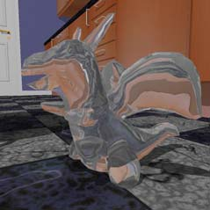
Results (cont..)
One Pass Shadow: 18.1 fps
Two Pass Shadow: 20.1 fps
1-bounce reflection: 9.1 fps
2-bounce reflection: 5.9 fps
3-bounce reflection: 3.9 fps
One Pass Shadow: 21.0 fps
Two Pass Shadow: 23.9 fps
1-bounce reflection: 11.3 fps
2-bounce reflection: 7.2 fps
3-bounce reflection: 5.0 fps

Slide 24
REAL TIME RAY TRACING ON GPU WITH BVH-BASED PACKET TRAVERSAL
Johannes G¨unther, Stefan Popov, Hans-Peter Seidel, Philipp Slusallek
MPI Informatik Saarland University MPI Informatik Saarland University

Slide 25
Motivation and Contributions
Existing research mostly for static scenes
Using a different acceleration structure, BVH
Contributions:
  BVH Based GPU Ray Tracer with Parallel packet traversal algorithm using shared stack
  A fast CPU based BVH construction algorithm
  Due to BVH use of larger sized scenes

Slide 26
Implementation: Parallel BVH Traversal
Previously, to avoid per ray stack:
  Tweaks to accelerated structures such as ropes
  Kd restart, to restart traversal after each leaf
  Resulting in large spatial data structure or suboptimal traversal
In this implementation:
  No per ray stack but a shared one
  Packets of rays traced and stack storage amortized over it
  BVH allows to remove per ray entry and exit distances

Slide 27
Traversal Algorithm
1 Thread = 1 Ray
1 Block = 1 Packet
A node at a time against a packet
If (node is a leaf):
Intersect ray with contained geometry
store the minimum intersection distance (d) for each thread
Else:
Load the two children of the node
Intersect packet with both to determine traversal order
Compute the intersection distance for every ray (d_new)
if (d_new > d)
That node is discarded
else:
Push the node onto the shared stack
Algorithm decides as to which node to decend to with the packet first by taking the one that has more rays wanting to go to

Slide 28
Traversal Algorithm (cont..)
If atleast 1 node wants to visit the other node, then that node pushed onto the stack
If no node wants to be visited or algorithm has reached a leaf, pop the stack and consider the next node
The algorithm terminates when stack is empty
The decision to determine the traversal order based on maximum rays wanting to go to which node in a packet:
  Parallel Sum Reduction
  Each thread writes a 1 in its own shared memory location if it wants to visit the right node else a -1
  The locations for a block are added
  If result less than 1 then left else right
Algorithm implemented in CUDA with one kernel for whole ray tracing pipeline

Slide 29

Fast BVH Construction (on CPU)
Secondary contribution
Use binning to approximate SAH cost function
Binary tree with AABBs
Goal is to choose the partition with minimum cost:
Where, K_{T} and K_{I} are cost consts for traversal and intersection
n_{l} and n_{r} are no. of primitives in respective child nodes
Partitions are then chosen based on the centroids of primitives

Slide 30
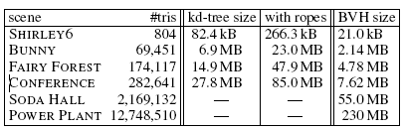
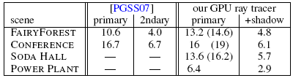
Results
Memory Requirements
BVH requires 1/3 - 1/4 of the space of kd-trees and about 1/10th of the space as that of kd-tree with ropes
Ray Tracing Performance
1024x1024 images ray traced
Comparison in fps with another fast ray tracing algorithm

Slide 31
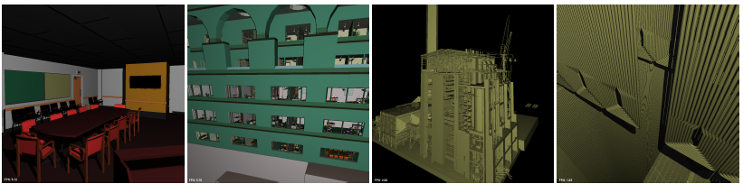
Results (cont..)
Conference Hall (6.1 fps)
SODA Hall (5.7 fps)
Power Plant (2.9 fps)
Power Plant Furnace (1.9 fps)

Slide 32
Critique
The Paper on BVH tree traversal algorithm is impressive but certain questions remain:
  None of the results show the correct optical effects like shadows and reflections
  No mention about secondary rays which might be the difference in their comparisons
  BVH Construction on CPU
The paper on Ray Tracing with CUDA does not talk much about the speeding up of actual intersection tests
None of the algorithms talk about sampling for anti-aliasing, one of the important things to produce better images

Slide 33
Summary
The GPUs’ computation power increasing with every new release
Better support for GPGPU operation, in turn better support for Ray Tracing
Current Ray Tracing Algorithms are great for static scenes, however dynamic scene handling needs more research
Movement towards stackless algorithms seem to be a promising direction to make things faster

Slide 34
References
Real time Ray Tracing on GPU with BVH-based Packet Traversal (2007)
Johannes G¨unther, Stefan Popov, Hans-Peter Seidel, Philipp Slusallek
Real Time Ray Tracing using CUDA
Min Shih1, Yung-Feng Chiu¹, Ying-Chieh Chen¹, Chun-Fa Chang²
Ray Tracing on Programmable Graphics Hardware (2002)
Timothy J. Purcell Ian Buck William R. Mark Pat Hanrahan
Stackless KD-Tree Traversal for High Performance GPU Ray Tracing (2007)
Stefan Popov, Johannes Günther, Hans-Peter Seidel, Philipp Slusallek
Fast Ray Sorting and Breadth-First Packet Traversal for GPU Ray Tracing (2010)
Kirill Garanzha, Charles Loop

Slide 35
QUESTIONS?

